Slide 1
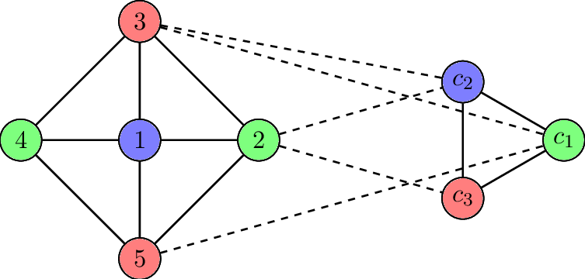
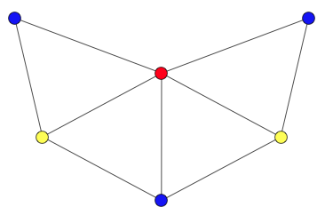
Graph Coloring and its Applications
By Mrinal Kanti Saha
Regd. No. 184415

Slide 2
A little recap...
Definitions :-
Graph G – Pair ( V(G), E(G) ) , where
V(G) is a non-empty finite set of vertices or points and
E(G) is a set of unordered pairs of distinct elements of V(G).
Adjacency – If (u, v) ∈ E(G), the vertex v is adjacent to u.
Undirected Graphs – If (u, v) ∈ E(G) then (v, u) also ∈ E(G).
Directed Graphs – If (u, v) ∈ E(G) then (v, u) may or may not ∈ E(G).
Degree of a Graph – The number of edges incident to the vertex.

Slide 3
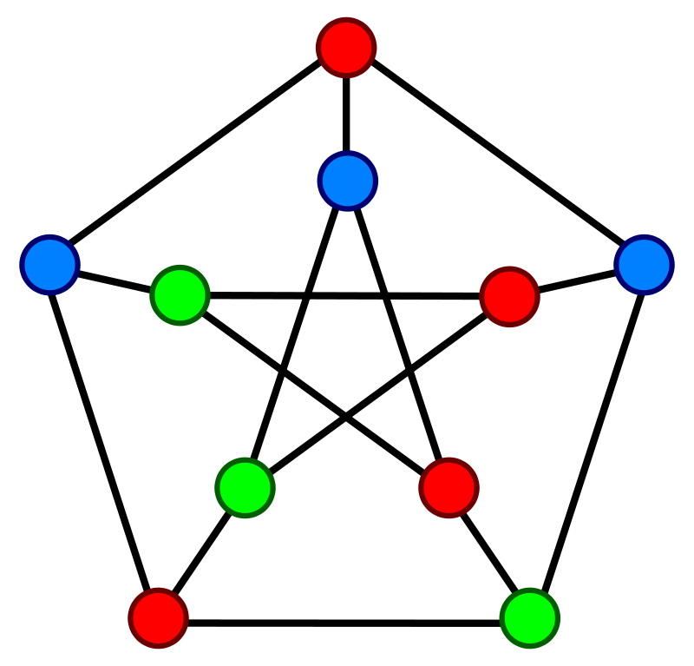
Graph coloring
In graph theory, graph coloring is a special case of graph labeling; it is an assignment of labels traditionally called "colors" to elements of a graph subject to certain constraints.
There are basically 3 types of graph coloring (in undirected graphs) :-
Vertex Coloring,
Edge coloring,
Face coloring.

Slide 4
Types of coloring
Vertex coloring - A way of coloring the vertices of a graph such that no two adjacent vertices are of the same color.
Edge coloring - Assigns a color to each edge so that no two adjacent edges are of the same color.
Face coloring - Assigns a color to each face or region so that no two faces that share a boundary have the same color (for maps).
Note : The latter two (edge and face) can be extrapolated into a vertex coloring problem.

Slide 5
History
Timeline :-
1852 – Francis developed the concept of map coloring in which no two region sharing common boundaries received the same color.
1879 – Kempe claimed to have proven the 4-color theorem.
1890 – Heawood proved Kempe’s argument wrong.
1912 – Birkhoff introduced the chromatic polynomial.
1976 – Appel & Haken finally proved the 4-color theorem.
2002 – Seymour, Robertson & Thomas established the strong perfect graph theorem.

Slide 6
Some important terms...
A coloring using at most k colors is called a (proper) k-coloring.
Chromatic Number: The smallest number of colors needed to color a graph G.
Chromatic polynomial :-
It counts the number of ways a graph can be colored using no more than a given number of colors.
As the name indicates, for a given G the function is indeed a polynomial in k.*
* where k is the no. of colors

Slide 7
Algorithms
NO efficient algorithms available*.
Only approximate algorithms.
  NO guarantees on minimum number of colors.
  Guarantees an upper bound on the number of colors.
* a.k.a. NP-Complete Problem

Slide 8
Greedy Algorithm
Basic Greedy Coloring Algorithm:-
1. Color first vertex with first color.
2. Do following for remaining V-1 vertices.
a) Consider the currently picked vertex and color it with the lowest numbered color that has not been used on any previously colored vertices adjacent to it.
b) If all previously used colors appear on vertices adjacent to v, assign a new color to it.
3. Halt.

Slide 9
Heuristics used...
The quality of the resulting coloring depends on the chosen ordering.
If the vertices are ordered according to their degrees, the resulting greedy coloring uses at most colors, at most one more than the graph’s maximum degree. Called the Welsh–Powell algorithm.
This kind of algorithms are called sequential coloring algorithms.

Slide 10
Applications of Graph coloring
Register Allocation,
Scheduling,
Sudoku,
Map Coloring,
Checking a graph is bipartite or not.

Slide 11
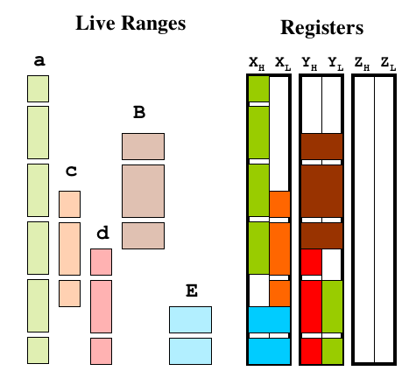
Register Allocation

Slide 12
Understanding Register Allocation
Register allocation is the process of determining which values should be placed into which registers and at what times during the execution of the program.
There will always be some pieces of code that require more registers than actually exist. In such cases, the register allocator must insert spill code to store some values back into memory for part of their lifetime.
Minimizing the runtime cost of spill code is a crucial consideration in register allocation.
Register Allocation is done by the compiler

Slide 13
Its corresspondence to Graph Coloring
The recognition of this correspondence is originally due to John Cocke.
First proposed this approach in 1971.
It was first implemented by G. J. Chaitin and his colleagues in 1981.
In the PL.8 compiler for IBM's 801 RISC prototype.

Slide 14
Formulation
Each node in the graph represents the live range of a particular value.
A live range is defined as a write to a register followed by all the uses of that register until the next write.
An edge between two nodes indicates that those two live ranges interfere with each other because their lifetimes overlap.
The resulting graph is thus called an interference graph.
The register allocation problem becomes equivalent to coloring the graph using as few colors (registers) as possible.

Slide 15
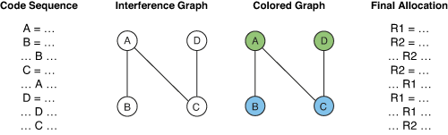
Interference Graph
Note : The above graph is only for demonstration purposes.
The graph is never this simple.

Slide 16

Steps
Determine the live ranges.
Construct the interference graph.
Eliminate unneeded copies (Coalesce phase).
Rebuild the graph.
Calculate Spill costs for each node.
Pruning (Simplify phase)
Select phase
Figure – The graph coloring process.

Slide 17
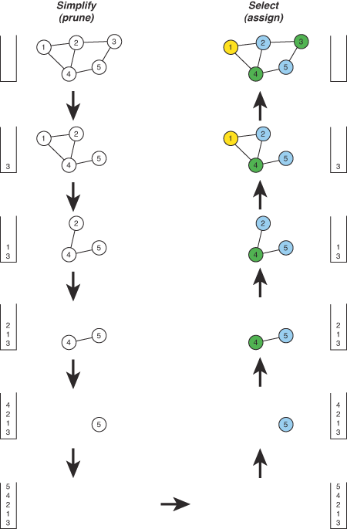
Simplify Phase
Nodes with fewer than k* neighbors are removed.
Each node is removed it is placed on a stack and its edges are removed from the graph.
If a point is reached where every node has k neighbors (or more), a node is chosen as a possible spill candidate.
Once a spill candidate is chosen, the node is then removed from the graph and pushed onto the stack, just like the others, and the algorithm continues on to the next node.
* where k= 3 (here) is the no. of registers available

Slide 18
Select Phase
Popping a node off the stack, re-inserting it into the graph, and assigning it a color different from all of its neighbors.
If a situation occurs where no color is available. the node is marked for spilling and remains uncolored while the algorithm continues on to the next node.

Slide 19

Scheduling

Slide 20
Types of Scheduling Problem
Some of the typical scheduling problems include-
• Timetable Scheduling
a. Course Timetable Scheduling - courses sharing common resources to be scheduled in conflict-free time-slots,
b. Exam Timetable Scheduling - exams sharing common resources to be scheduled in conflict-free time-slots,
• Aircraft Scheduling,
• Job Shop Scheduling.

Slide 21
Course Timetabling
Course Timetabling is the scheduling of a set of related courses in a minimal number of time-slots such that no resource is required simultaneously by more than one event.
In a typical educational institute resources, which may be required by courses simultaneously can be students, classrooms and teachers.
Constraints are the various restrictions involved in creating a schedule.
No two subjects having common students can be scheduled in the same time-slot,
No courses can be scheduled to the same classroom at same time-slot,
More than one course taught by the same teacher cannot be assigned same time of the week.

Slide 22
Formulation
For solving Course Timetable scheduling problems using graph coloring, the problem is first formulated in the form of a graph where courses act as vertices.
Depending on type of graph created, edges are drawn accordingly.
Edges are drawn between conflicting courses having common students, common teachers, common classrooms, etc.

Slide 23
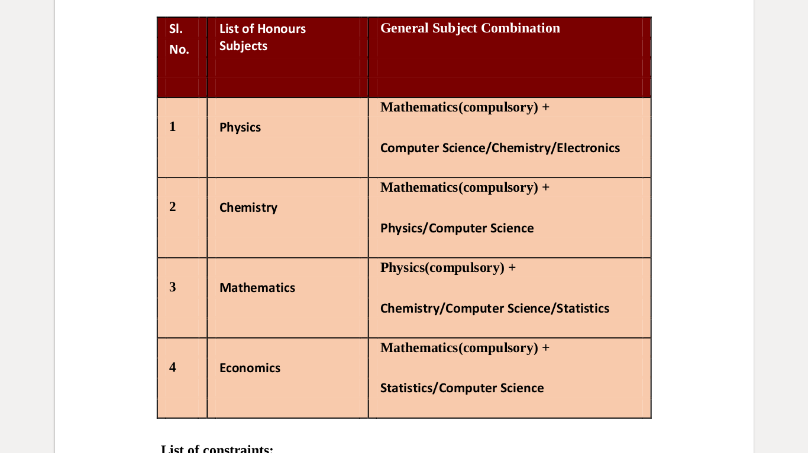
Example
Problem : Given Adjacent table find minimum number of time slots to schedule all the courses without conflict.
List of constraints :
• Courses having common student cannot be allotted at the same time slot onthe same day.
• Total number of available periods is 8.

Slide 24
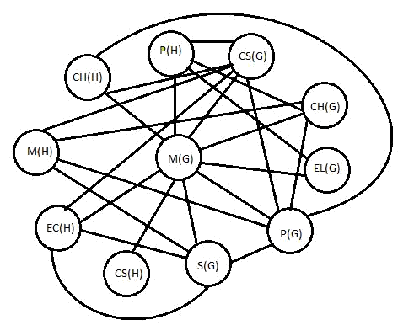
Solution
N.B. (H) and (G) notations represent Honours and General courses respectively.
CH- Chemistry, M- Mathematics,
EC-Economics, CS-Computer Science,
P-Physics, S-Statistics, EL-Electronics.
After applying graph coloring algorithm, the resultant graph in Figure beside is properly colored with chromatic number 4.

Slide 25
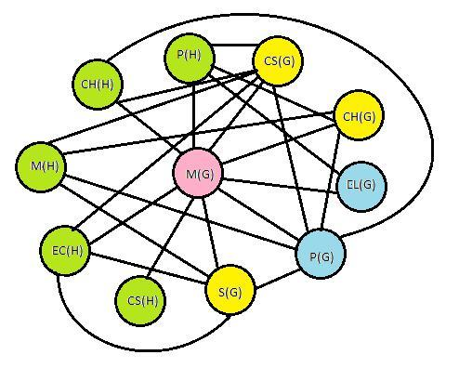
Result
In the above solution, the hard constraints are satisfied properly.
The resultant minimum number of time slots needed is 4 which do not exceed the total available 8 periods.
Similarly, no student overlapping between Electronics and Physics General, or students between Chemistry, Computer Science and Statistics General.
Figure - Colored Conflict Graph

Slide 26
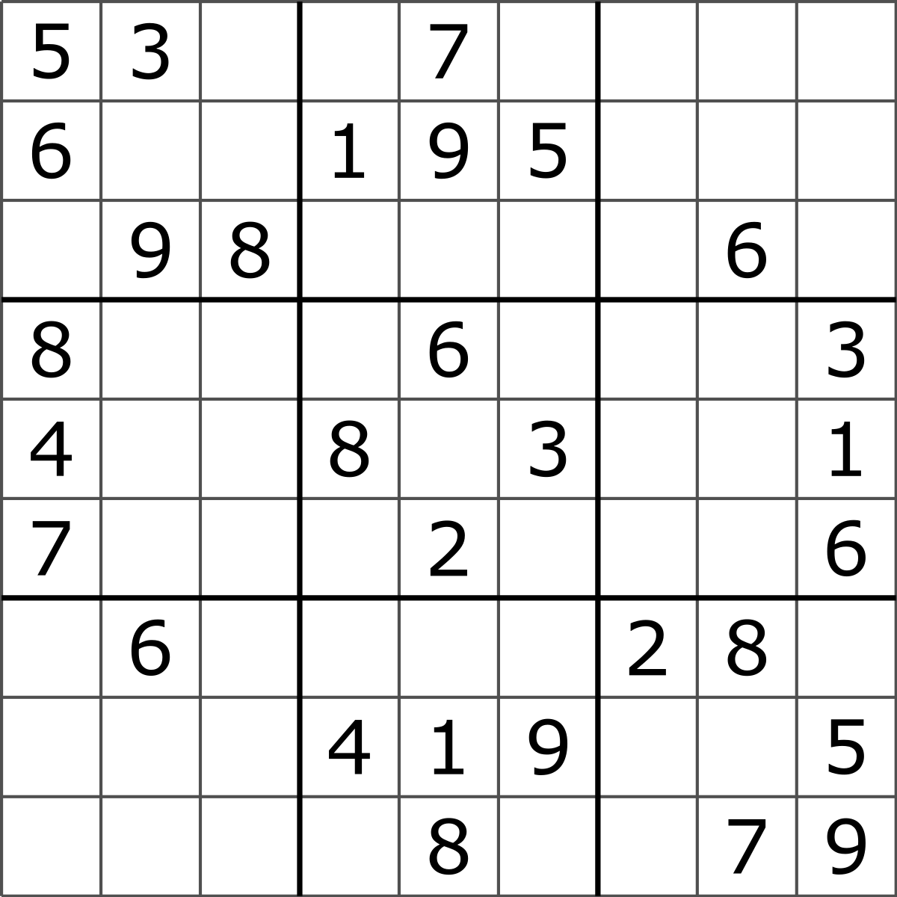
Sudoku

Slide 27
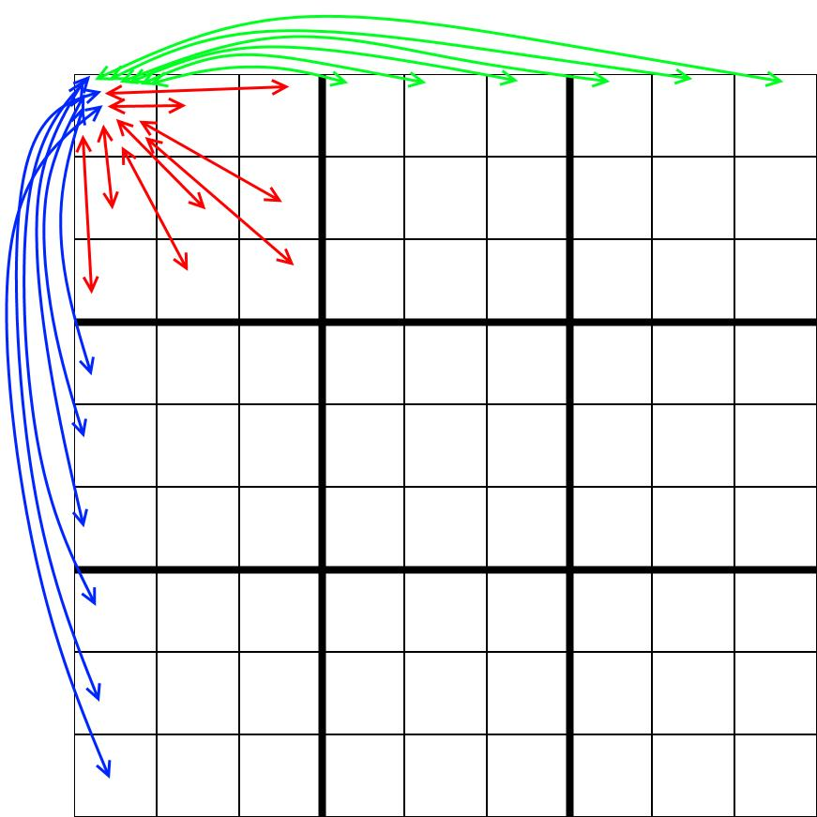
Formulation
Sudoku is one of the most famous number placement-puzzle and it is also a variation of Graph-coloring problem.
Where, every cell represents a vertex.
There is an edge between two vertices if they are in same row or same column or same block.

Slide 28
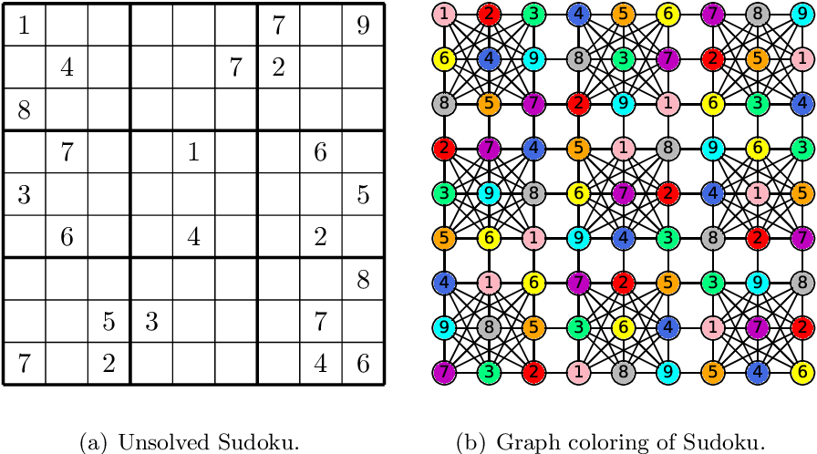
The Sudoku graph

Slide 29
References
[1] Wikipedia
[2] Geeks for Geeks
[3] Register Allocation By Graph Coloring
(by Jason Robert Carey Patterson)
[4] A Study on Course Timetable Scheduling using Graph Coloring Approach
(by Runa Ganguli and Siddhartha Roy)
[5] Google Images

Slide 30
Thank you...

